Slide 1
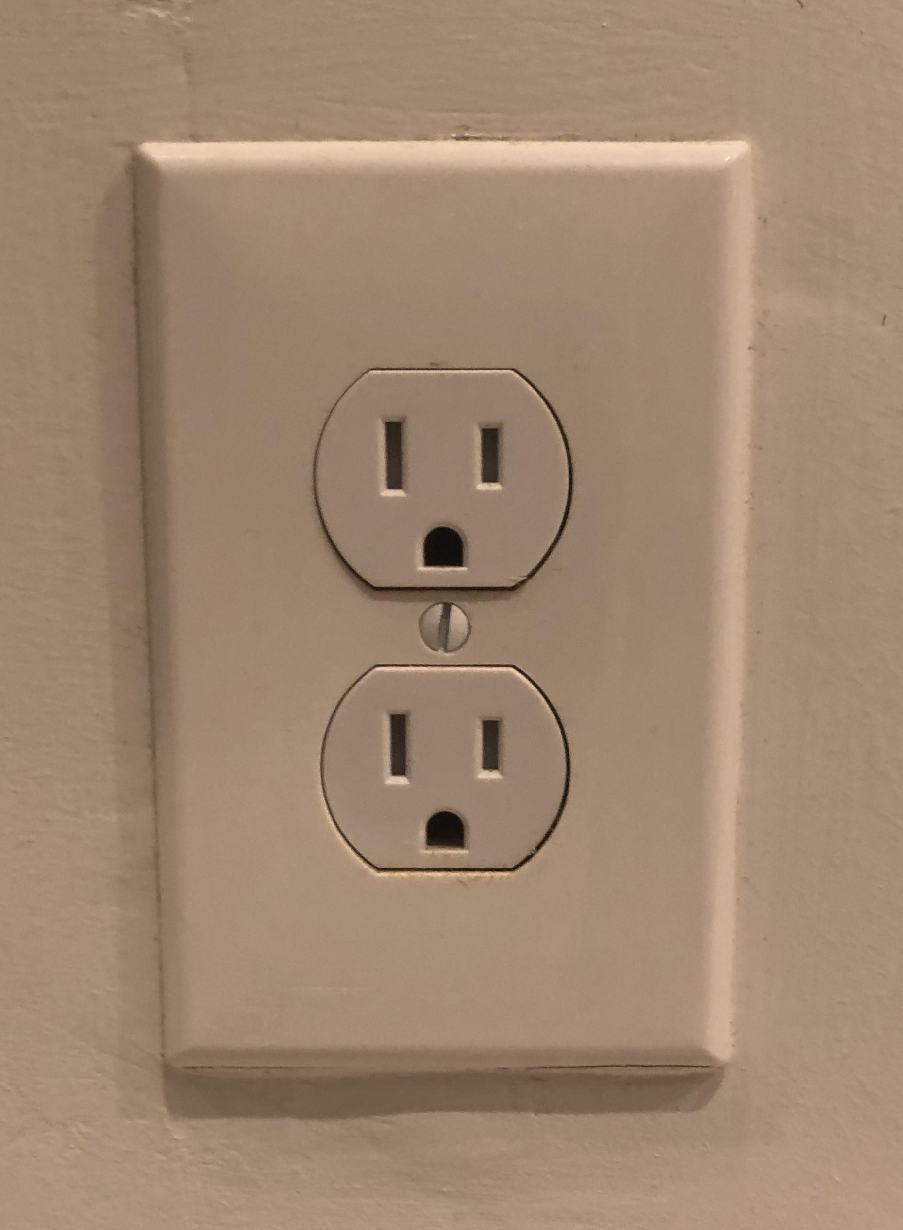
Equipment
Ground

