Slide 1

Key Requirements for Surface Combatant Electrical Power
System and Propulsion System Design
Dr. Norbert Doerry, NAVSEA (SEA 05T)
Dr. John Amy, Jr., NSWC PD
Advanced Machinery Technology Symposium
ASNE AMTS 2020
April 1-2, 2020
Philadelphia, PA

Slide 2

Setting the Scene
“In FY2030, the DON plans to start building an affordable follow-on, multi-mission, mid-sized future surface combatant to replace the Flight IIA DDG 51s that will begin reaching their ESLs [Estimated Service Life] in FY2040.”
    Report to Congress on the Annual Long-Range Plan for Construction of Naval Vessels for FY2015
Big differences from DDG 51:
High-energy weapons and sensors
Flexibility for affordable capability updates
Photo by CAPT Robert Lang, USN (Ret), from site
http://www.public.navy.mil/surfor/swmag/Pages/2014-SNA-Photo-Contest-Winners.aspx
Getting the Requirements right is critically important
Notes:
According to Long Range Shipbuilding Plan, DDG 51 replacement will be awarded in 2030
DDG 51 has been an outstandingly successful design, but two factors will drive it’s replacement:
First is that sensors and weapons are coming online that overtax the current electrical plant.
Second is that tight budgets mean that the Navy will need long service lives from new designs, and they must be affordable to adapt to evolving threats and missions.

Slide 3
Power and Propulsion Architectures
Mechanical Drive
Integrated Power (and Energy) Systems (IPS / IPES)
Hybrid Drive
Hybrid Drive with Propulsion Derived Ship Service Power (PDSS)
Power and Propulsion Architectures have 1st order impact on ship design

Slide 4
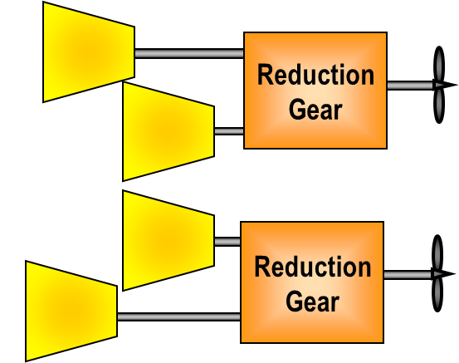

Mechanical Drive
Propulsion Prime Movers and drive train sized for sustained speed.
  Achieve Sustained Speed at 80% of rated power in calm water, clean bottom, etc.
  Should be efficient at endurance conditions
Ship service sized for maximum margined ship service load with one of the largest rated generators offline
  For systems with 3 generator sets, an increase in load of 1 kW requires 1.5 kW increase in generation capacity
Generally at least 3 prime movers online
  One or more propulsion engines
  Two or more ship service generators
    Sufficient energy storage can reduce to one indefinitely or zero for short times

Slide 5
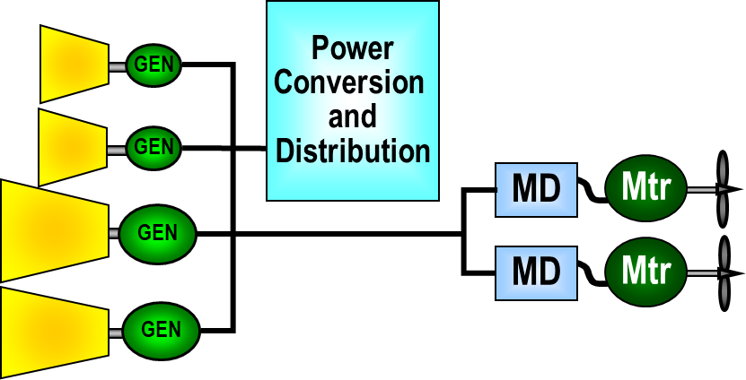
Integrated Power (and Energy) Systems
Propulsion Motors and drive train sized to achieve sustained speed
  Should be efficient at endurance conditions
Power Generation sized for maximum propulsion power and maximum ship service power when at maximum propulsion power.
  Must be able to achieve a lower speed with largest generator offline
  Usually, an increase in load of 1 kW requires 1 kW increase in generation capacity.
Generally at least 2 prime movers online
  Sufficient energy storage can reduce to one indefinitely or zero for short times
Integrated Power and Energy Systems (IPES)
  Integrated Power System (IPS)
  Energy Storage
  Advanced Controls

Slide 6
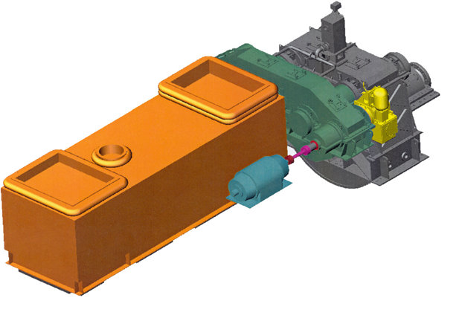
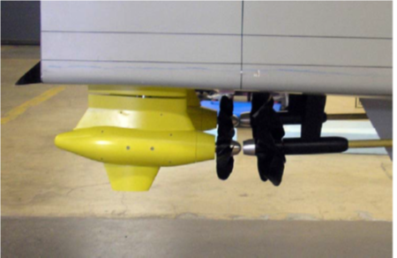
Hybrid Drive
Mechanical Drive + Auxiliary Propulsion Unit
  Auxiliary Propulsion unit typically electric motor with VFD
    Integrated with reduction gear, or
    Integrated with propulsion shaft
    Pod augmenting traditional shaft
  LHD 8 and LHA 6 classes
  Allows N+1 generator to be used for propulsion
  Improves fuel economy at low speed
‘OR’ Propulsion
  Either Motor or Prime mover driving shaft, but not both at the same time.
  Simplifies motor and motor drive
  Must be able to meet sustained speed without motor
‘AND’ Propulsion
  Motor can augment prime mover to achieve sustained speed requirement
  More complex motor and drive
  Enables smaller prime mover for propulsion

Slide 7
Hybrid Drive with PDSS
Variation of Hybrid Drive
Propulsion Derived Ship Service (PDSS)
  Motor can act as a generator to enable mechanical drive prime mover to generate electricity
  Usually uses power electronics to produce distribution voltages and frequencies.
Can replace ship service generator if power can be generated independent of shaft rpm.
  Controllable Reversible Propellers are an enabler
More complex fault detection, localization, and isolation system integration for a.c. systems.

Slide 8
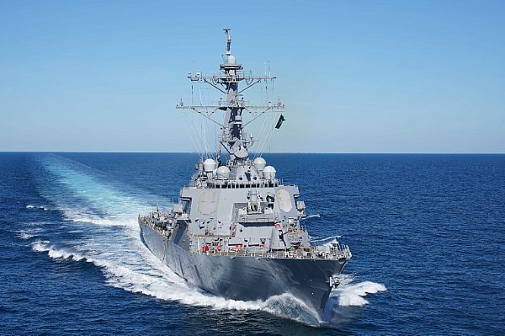
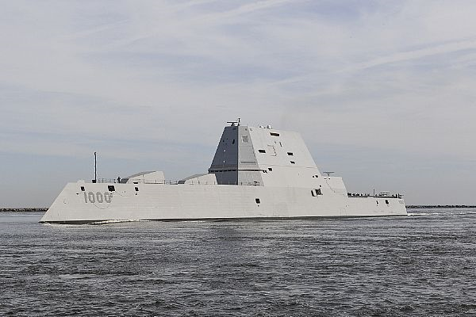
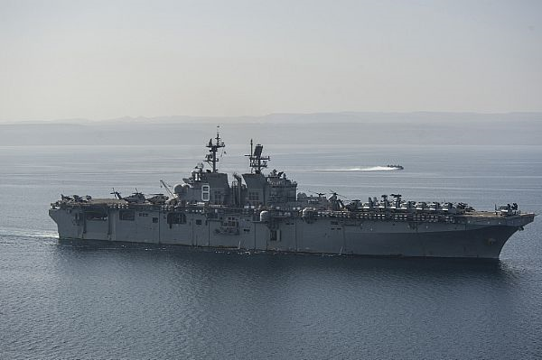
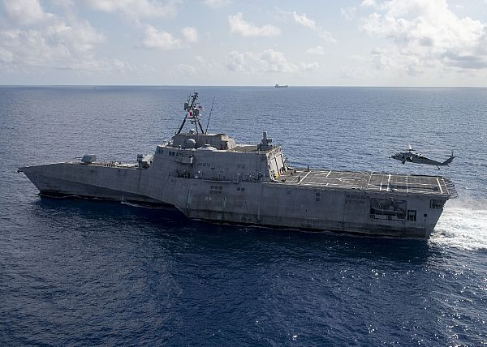
Key Requirements for naval power and propulsion systems
200203-F-RN211-1061
U.S. Air Force photo by Master Sgt. Ryan Crane
161025-N-UK306-017
U.S. Navy photo by Petty Officer 2nd Class Timothy Schumaker
Flexibility
Sustained Speed
Endurance
“Compromised Mobility” Speed
Survivability
Low Observable Mode
Operating and Support Costs
161206-N-GB595-556
U.S. Navy photo by Petty Officer 1st Class Mathew J. Diendorf
200128-N-AT530-1052
U.S. Navy photo by Mass Communication Specialist 2nd Class Chris Roys

Slide 9
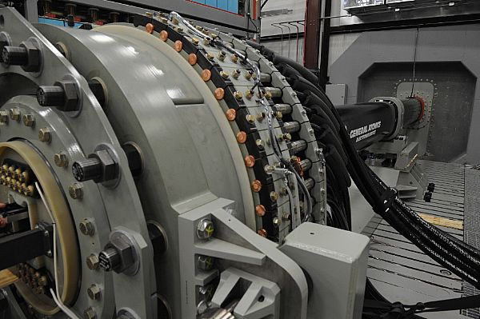
Flexibility
Mechanical Drive
  Requires the most amount of installed ship service generation capacity
  Requires most amount of energy storage to buffer pulsed sensors and weapons.
IPS / IPES
  Best capability to integrate high power and pulsed sensors and weapons
Hybrid Drive
  Intermediate capability
Hybrid Drive with PDSS
  Intermediate capability, slightly better than without PDSS
120621-N-PO203-129 U.S. Navy photo by John F. Williams

Slide 10
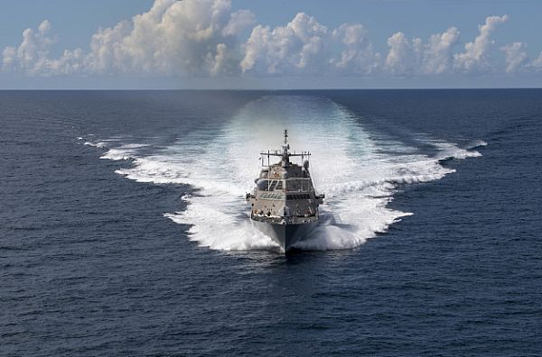
Sustained Speed
Mechanical Drive
  Unless using combining gears, need even number of prime movers
  Limited selection of prime movers
IPS / IPES
  Motors tailored to required power
  Can use any number of prime movers
  Unless using pods or contra-rotation, efficiency at sustained speed typically less than for Mechanical Drive.
Hybrid Drive
  OR configuration has same impact as Mechanical Drive
  AND configuration reduces required rating of propulsion prime movers
Hybrid Drive with PDSS
  If used to replace generator set, prime mover rating must be greater than for mechanical drive
  Improves fuel efficiency by providing a minimum load to the prime mover.
191117-N-DW182-2371 U.S. Navy photo by Mass Communication Specialist 2nd Class Devin Bowser
Sustained Speed is intended to be the speed a ship can achieve in real world conditions by specifying the power at ideal conditions

Slide 11
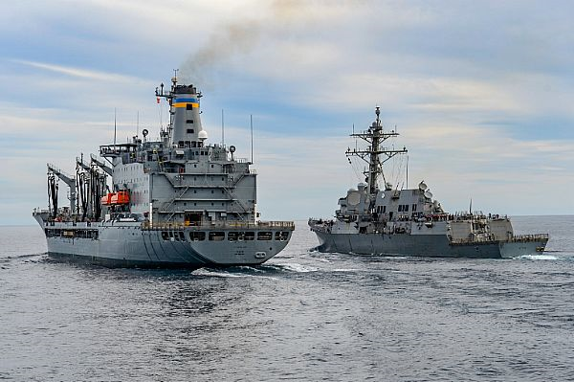
Endurance
200119-N-CU072-1014 U.S. Navy photo by Mass Communication Specialist 3rd Class Sean Lynch
Mechanical Drive
  Typically best for “Surge To Theater”
  Good for “Economic Transit”
  Typically worst for “Operational Presence”
IPS / IPES
  Typically best for “Operational Presence”
  Good for “Economic Transit”
  Typically worst for “Surge to Theater”
Hybrid Drive
  Good for “Operational Presence”
  if of sufficient capability good for “Economical Transit”
Hybrid Drive with PDSS
  Typically somewhat better than Hybrid Drive
  Can reduce fuel consumption to improve fuel usage
Endurance Metrics (DPC 200-1)
Surge to theater distance
Economical transit distance
Operational presence time
Endurance Requirements determine size of Fuel Tanks

Slide 12
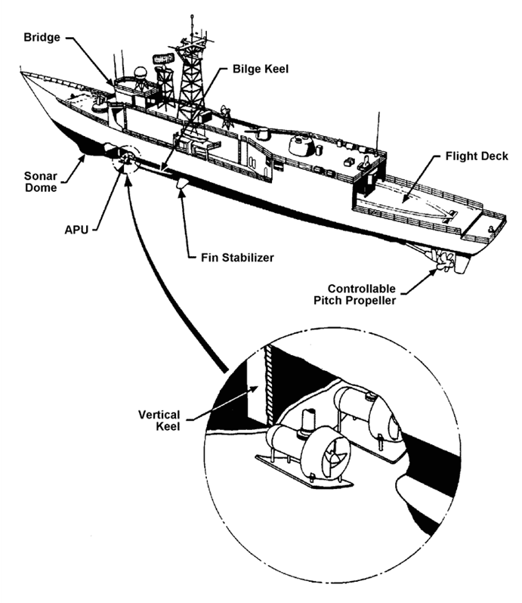
‘Compromised Mobility’ Speed
If below about 14 knots
  Forward Retractable Pod may be feasible
  Reduced need for main propulsion separation
If above about 14 knots
  Main propulsion must be longitudinally separated and shafts protected
Mechanical Drive
  50% power (~80% of maximum speed)
IPS / IPES
  Greater machinery arrangement flexibility
Hybrid Drive & Hybrid Drive with PDSS
  Impact about the same as for Mechanical Drive
Shifter3 on https://www.rcgroups.com
The degree to which mobility (propulsion) is
allowed to degrade following exposure to a
threat (either weapons effect or accident)

Slide 13
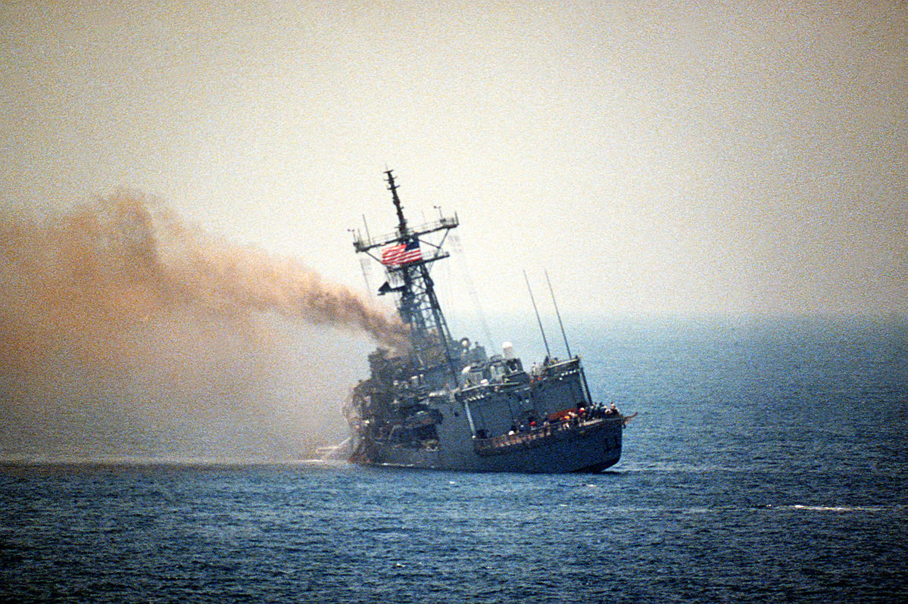
Survivability
Mechanical Drive
  Electrical Power Generation Plant can power all Mission Critical Equipment with at least 1 generator out of service.
IPS / IPES
  Best ability to have sufficient power to Mission Critical Equipment
Hybrid Drive
  About the same as for Mechanical Drive
  Use of pods may improve survivability
Hybrid Drive with PDSS
  PDSS may improve post-damage power generation capability
U.S. Navy Photo

Slide 14

Low Observable Mode
Mechanical Drive
  Not many opportunities to minimize IR or acoustic signatures
IPS / IPES
  Likely has a lower IR signature than Mechanical Drive
  Acoustic signature can be better
  Option to run on Energy Storage alone
Hybrid Drive
  Likely better than Mechanical Drive
Hybrid Drive with PDSS
  Likely better than Hybrid Drive without PDSS
https://www.publicdomainpictures.net/en/view-image.php?image=33238&picture=ocean

Slide 15
Operating and Support Costs
Mechanical Drive
  Usually operates with more prime movers online that are lightly loaded
IPS / IPES
  Fewer prime movers online that operate more optimally loaded
Hybrid Drive
  Better than Mechanical Drive
Hybrid Drive with PDSS
  Better than Hybrid Drive without PDSS
Prime Mover maintenance tied to operating hours

Slide 16
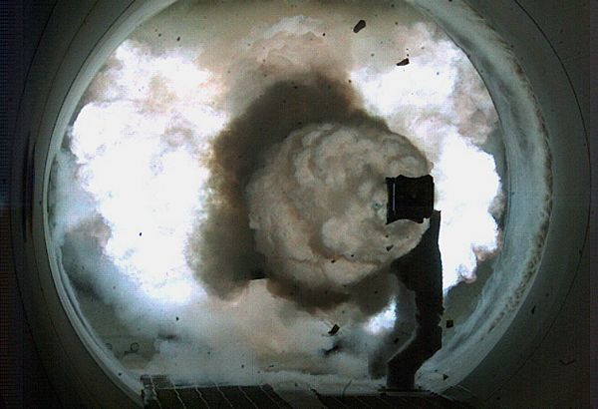
Technical Maturity
Development and Integration Engineering required for all power and propulsion systems.
Common Risks
  Design and implementation of control systems.
  Maintaining power quality on the power bus in the presence of modern loads
  Supporting pulsed loads
  Integrating energy storage
  Survivability of twin shafts
  Controlling common mode currents due to proliferation of power electronics
Specific Risks
  Pods
  Contra-rotation
  PDSS – Integration with fault DLI
  IPES with MVDC
    Fault DLI
    Switchgear and Cabling
    Equipment Specifications
    Bus stability via controls
101210-N-0000X-001, U. S. Navy Photo

Slide 17
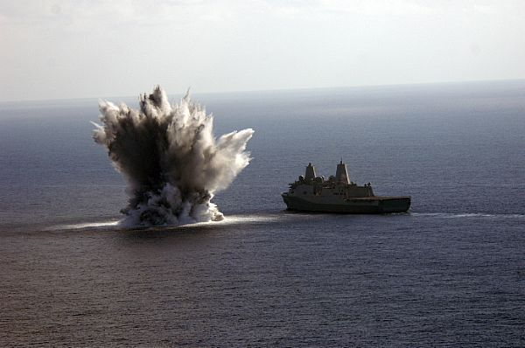
Recommended Studies
Survivability of twin shafts when subjected to damage from modern torpedoes.
Value of operating without any prime movers online for limited periods of time.
Modifications to commercial pods needed to meet naval surface ship requirements.
Viability of using forward propulsors for low speed operations where signatures are important.
080816-N-6031Q-001, U.S. Navy photo by Mass Communication Specialist 3rd Class David R. Quillen

Slide 18
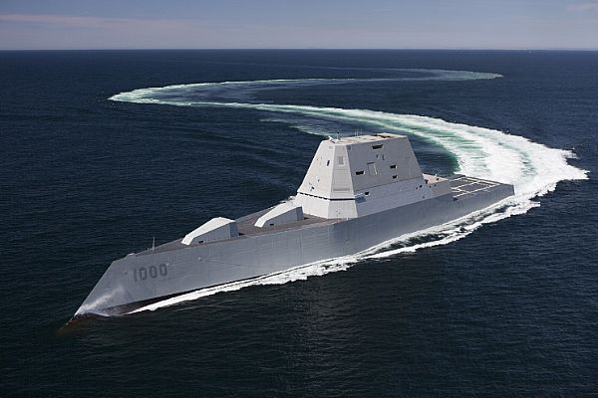
Factors that favor IPS/IPES over Mechanical Drive
Minimizing operating and support costs is important
The maximum margined ship service power load with SLA is large (> ~10 MW) and/or includes large pulse loads
Maximizing on-station time is important
The ship has an operational profile similar to today’s surface combatants
One wants the option to trade ship speed for supporting future high power loads
One wants to preserve the option to install multiple high power loads
Controlling the IR signature and/or acoustic signature is important
160421-N-YE579-005, U.S. Navy

Slide 19
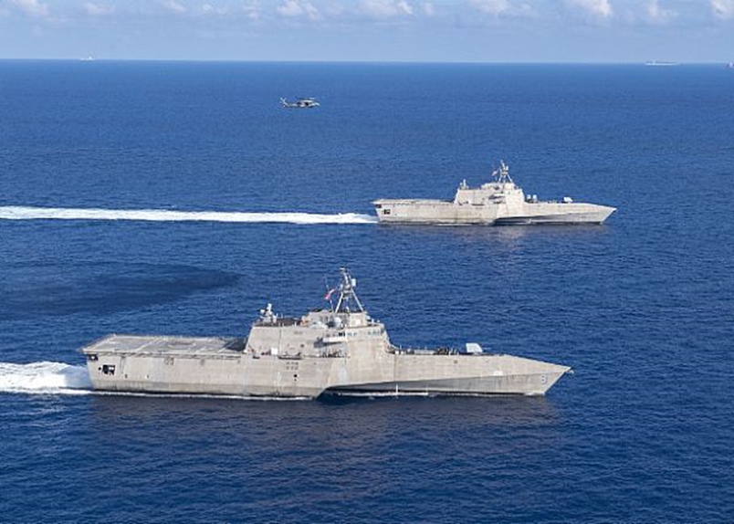
Factors that favor Mechanical Drive / Hybrid Drive over IPS/IPES
The maximum margined ship service power load with SLA is small (< ~ 8 MW) and does not include large pulse loads
The ship has an operational profile that emphasizes high speed operation
One doesn’t expect to install multiple newer higher power sensors and electric weapons over the ship’s service life. Growth will be limited to the specified SLA
IR and acoustic signatures are of lesser importance
200128-N-AT530-1919, U.S. Navy photo by Mass Communication Specialist 2nd Class Chris Roys

Slide 20
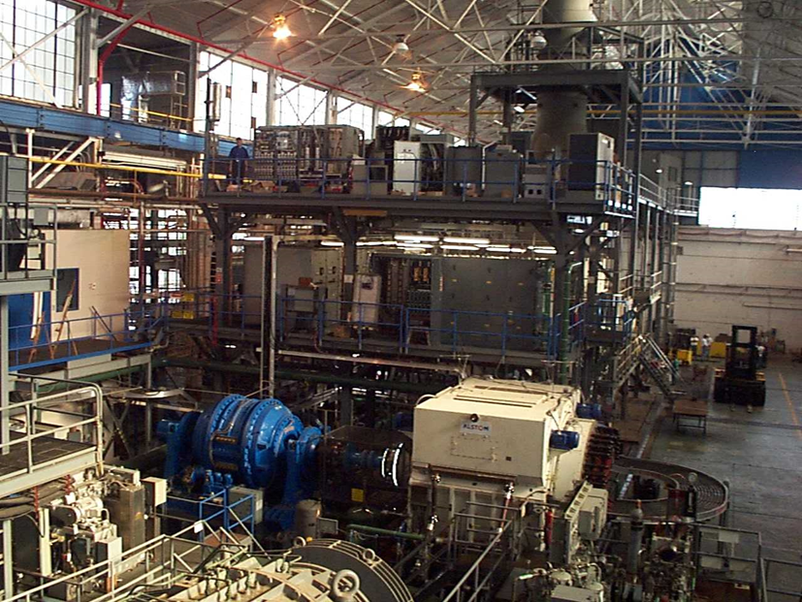
Concluding thoughts
Independent of the final choice of power and propulsion architecture, the following will likely be part of the solution:
  Advanced Controls
  Power Electronics
  Energy Storage
Successful integration of future power and propulsion systems require
  Robust Digital Engineering environment
  Power Hardware in the Loop and Control Hardware in the Loop simulation
  Integrated test facility
U.S. Navy Photo

